Slide 1


RFID and Motion Detection Based Access System
Mah Sung Kit

Slide 2


What Is Access Control
Access control is a method and system used to manage and restrict access to a specific area or system. It does this by regulating entry points and verifying identities to ensure that only authorised individuals or systems have access to the

Slide 3

Common physical security methods
In physical security, there are a number of common methods used to secure specific areas. These methods include closed circuit television (CCTV), access cards, fingerprint authentication systems, etc.

Slide 4
Project Requirement

Slide 5
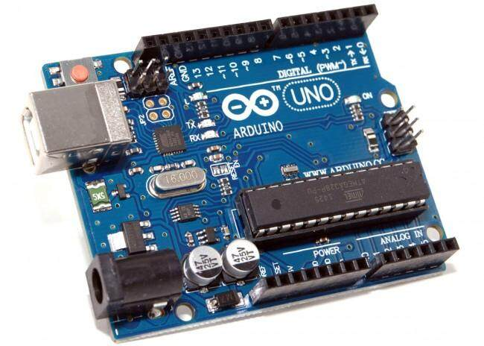
Arduino UNO R3

Slide 6
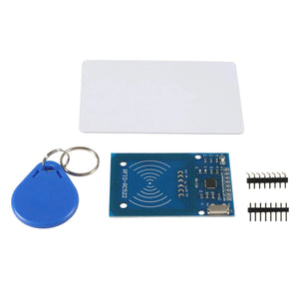
MFRC 522

Slide 7
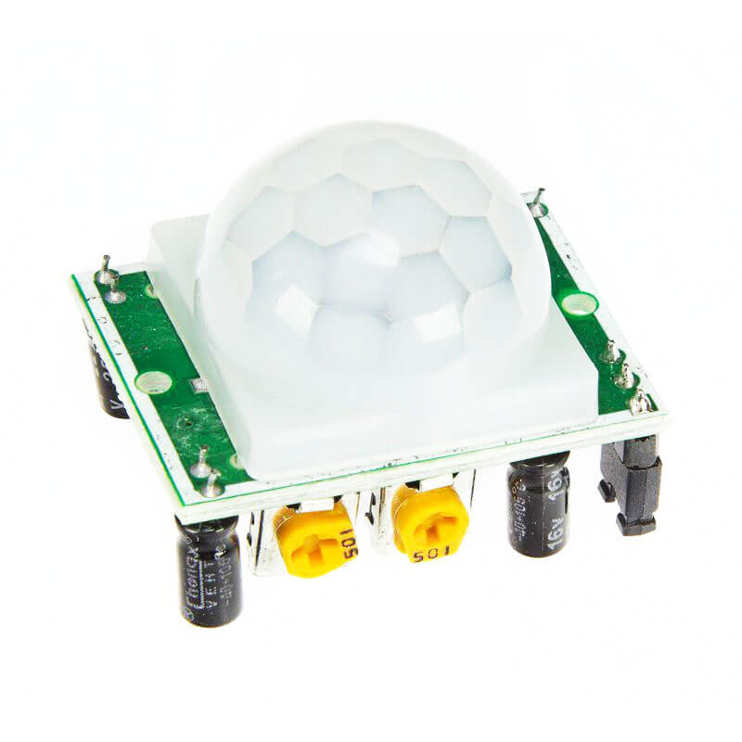
HCSR - 5001

Slide 8
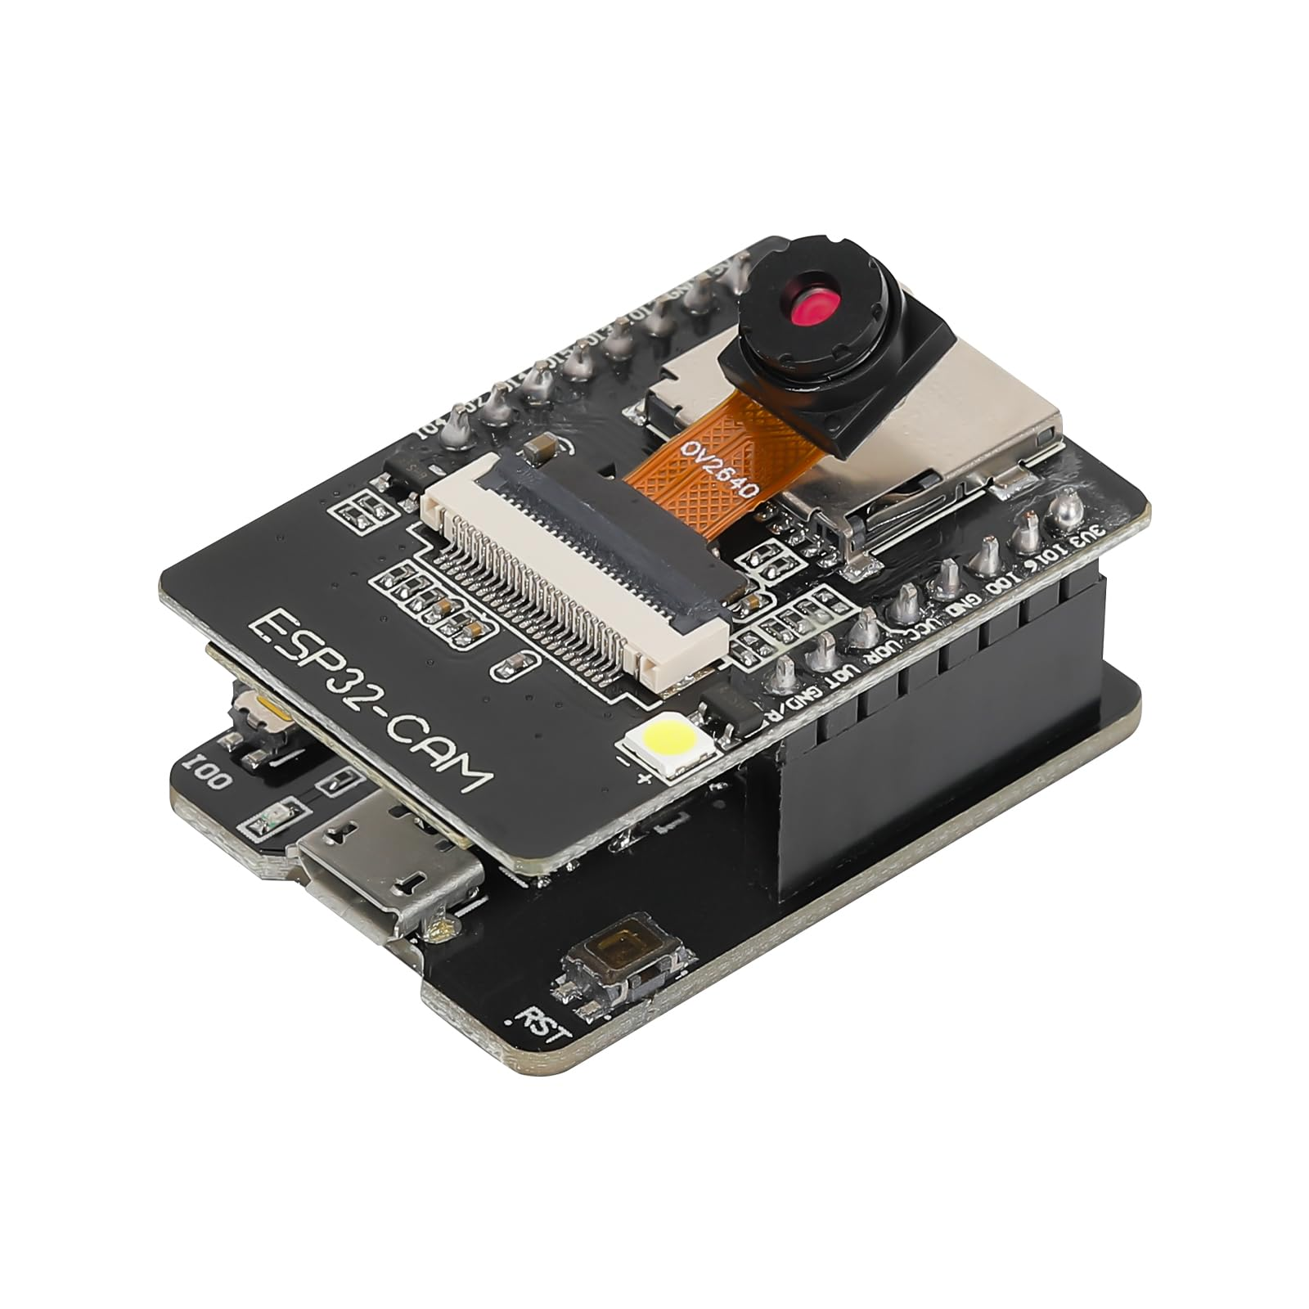
ESP32 - CAM

Slide 9
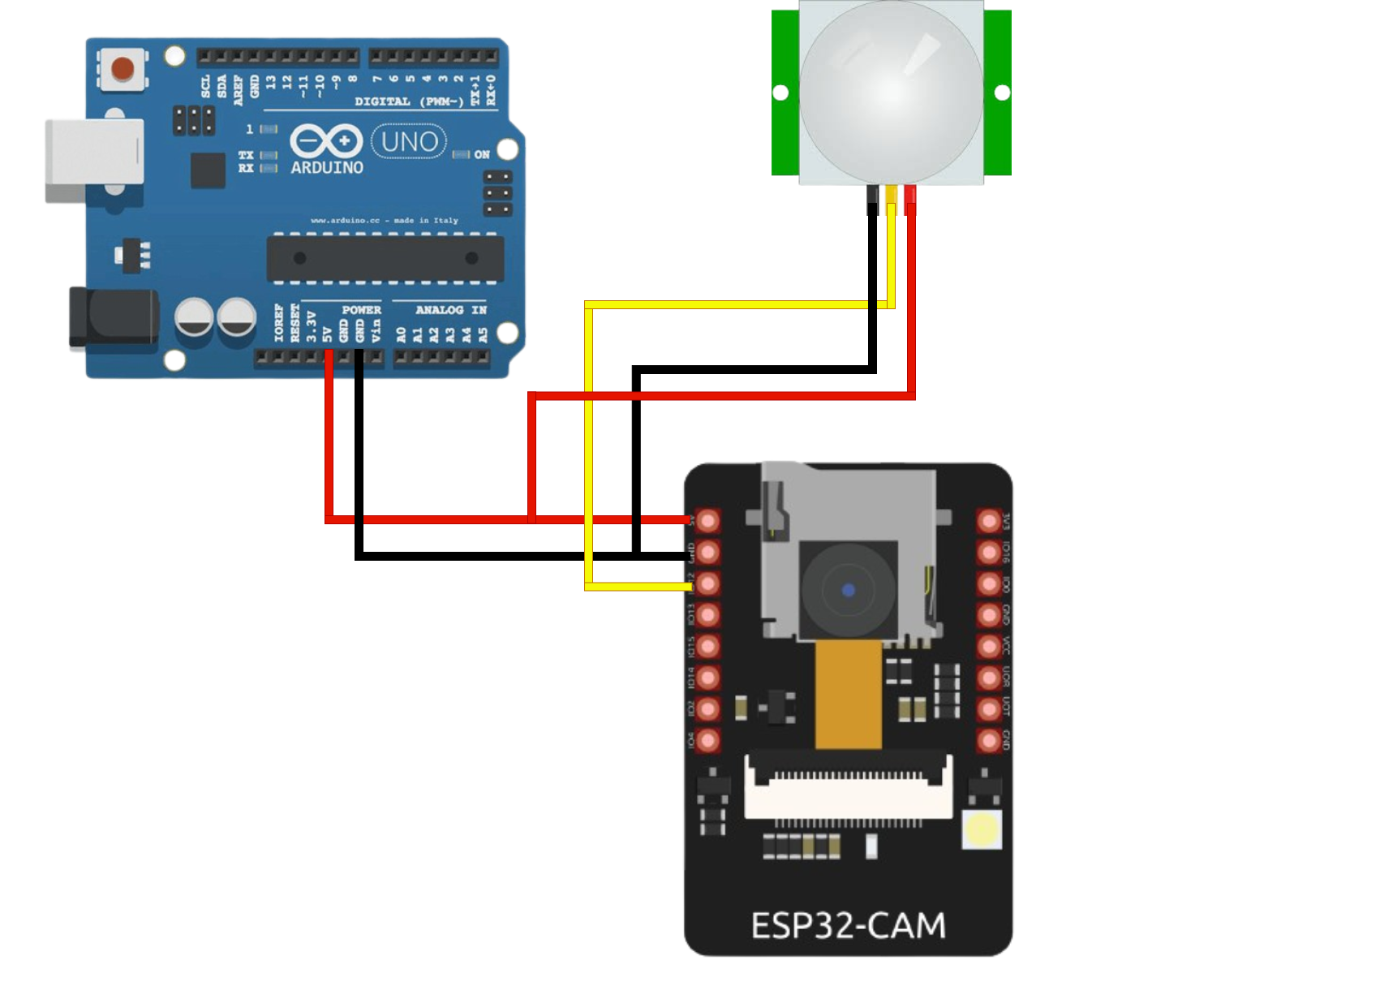
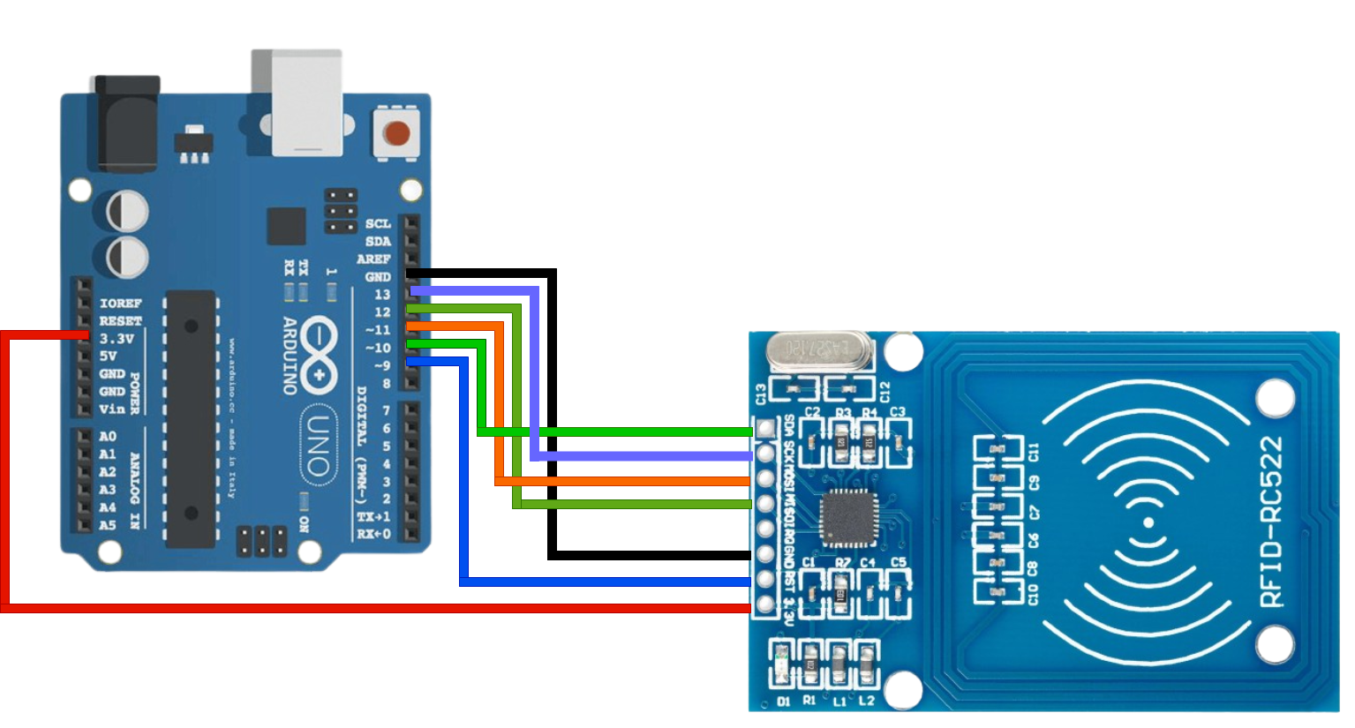
Circuit Diagram

Slide 10




App

Slide 11
Budget
No | Item | Quantity | Total Cost
1 | MFRC 522 | 1 | MYR 9.90
2 | HC-SR501 | 1 | MYR 5.90
3 | ESP32-CAM | 1 | MYR 25.90
4 | Arduino Uno R3 | 1 | MYR 27.90
5 | Jumper | 1 | MYR 3.00
 |  | Total | MYR 71.70

Slide 12

Demo

Slide 13
Conclusion
Through this project, I not only solved problems, but also gained valuable experience. During the project, I gained an in-depth understanding of the composition and operation of circuits, learnt the key steps to establish a connection with a server, acquired the skills to edit web pages through coding, as well as successfully explored and mastered a new programming language. These experiences not only made me more familiar with the technical field, but also enhanced my practical skills.
Notes:
通过这个项目，我不仅解决了问题，还获得了宝贵的经验。在这个项目中，我深入了解了电路的组成和工作原理，学会了与服务器建立连接的关键步骤，掌握了通过编码编辑网页的技能，还成功探索并掌握了一种新的编程语言。这些经历不仅让我对技术领域更加熟悉，也提高了我的实践能力。

Slide 14
THX

